Slide 1


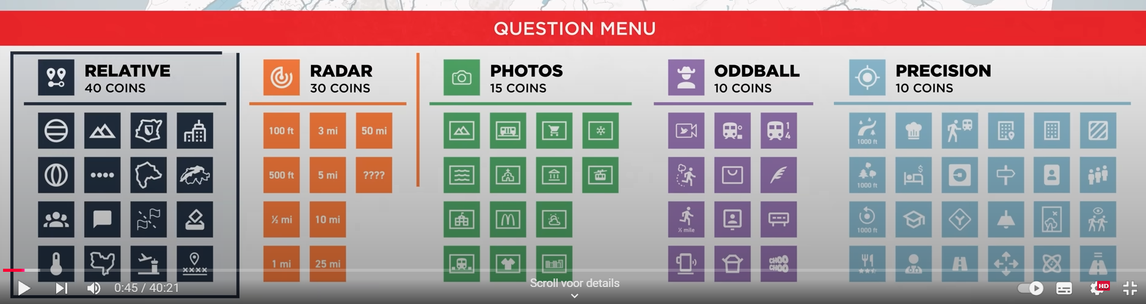
Rubik font

Slide 2

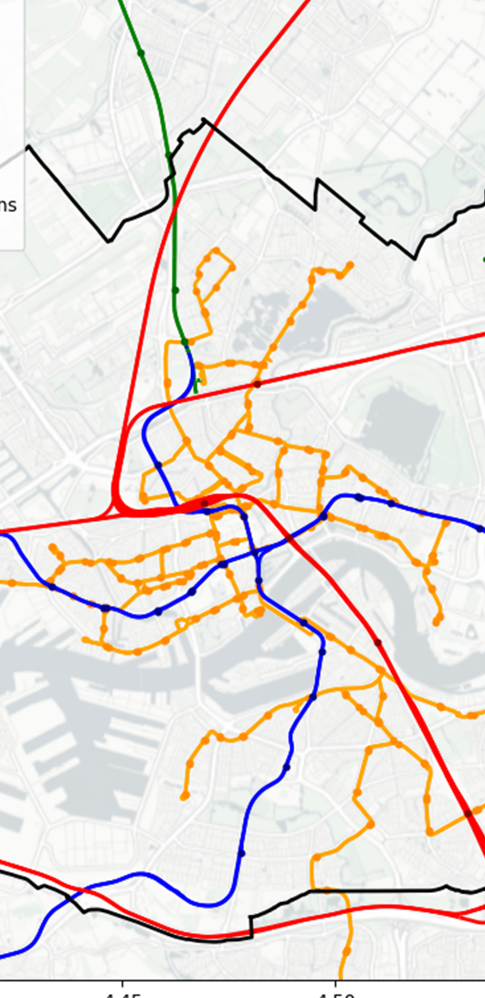





LEADERBOARD
MAPS
QUESTIONS
CURSES
E
L
1st
RUBEN
00:00:00
.
100
X
RELATIVE
40 COINS
2nd
BEYZA
00:00:00
.
100
3rd
KEES
00:00:00
.
100
X
RADAR
30 COINS | 00:00:00
100 m
500 m
1 km
2 km
X
PHOTOS
15 COINS
M
R
X
LEADERBOARD
MAP
QUESTIONS
CURSES
LEADERBOARD
MAP
QUESTIONS
CURSES
LEADERBOARD
MAP
QUESTIONS
CURSES
LEADERBOARD
MAP
QUESTIONS
CURSES
X=current location; R = ruler; L = legend/toggle; E = Exclude zones manually

Slide 3
LEADERBOARD
X
X
CREATE GAME
WHO IS PLAYING?
Ruben
1st
RUBEN
00:00:00
.
100
Beyza
Kees
2nd
BEYZA
00:00:00
.
100
Create
Import
Add
Confirm
3rd
KEES
00:00:00
.
100
Confirm can only be pressed once 2 players have been added.
X
X
IMPORT GAME
WHO ARE YOU?
Ruben [Blue]; Beyza [Red]; Kees [Green]
Ruben
Beyza
Kees
LEADERBOARD
MAP
QUESTIONS
CURSES
Paste
Confirm
Confirm
Confirm can only be pressed once game is pasted and correct
Confirm can only be pressed once player is selected.

Slide 4
QUESTIONS
X
X
X
ANSWER QUESTION
ANSWER QUESTION
ANSWER QUESTION
Are the hiders within a 1 km radius of the seeker's location?
[51.92, 4.46]
Are the hiders within a 1 km radius of the seeker's location?
[51.92, 4.46]
Send a picture of the hiders nearest McDonald’s
X
RELATIVE
40 COINS
OR
ANSWER
ANSWER
Paste
Confirm
Yes
Manually
X
RADAR
30 COINS | 00:00:00
Confirm can only be pressed once question is pasted and correct
Update excluded zones based on answer
100 m
500 m
1 km
2 km
X
X
X
ASK QUESTION
ANSWER QUESTION
ANSWER QUESTION
X
PHOTOS
15 COINS
Are the hiders within a 1 km radius of the seeker's location?
[51.92, 4.46]
Are the hiders within a 1 km radius of the seeker's location?
[51.92, 4.46]
Send a picture of the hiders nearest McDonald’s
M
OR
Disable question categories based on coins and cooldowns
ANSWER
ANSWER
LEADERBOARD
MAP
QUESTIONS
CURSES
Copy & Confirm
Yes
No
Manually
Update excluded zones based on answer

Slide 5
CURSES
X
GET CURSED
...
Show active curses
Cast a curse > Send a curse
List of all curses
Paste
Confirm
Confirm can only be pressed once question is pasted and correct
X
CAST CURSE
SEND CURSE
…
…
LEADERBOARD
MAP
QUESTIONS
CURSES
…
Copy & Confirm

Slide 6
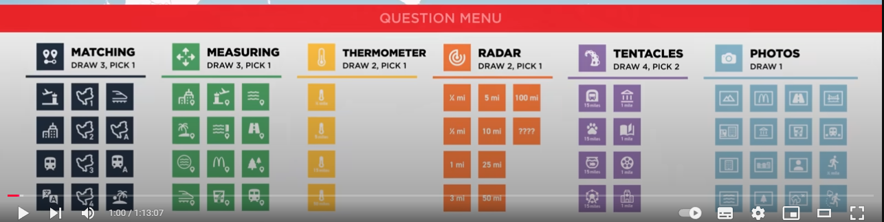
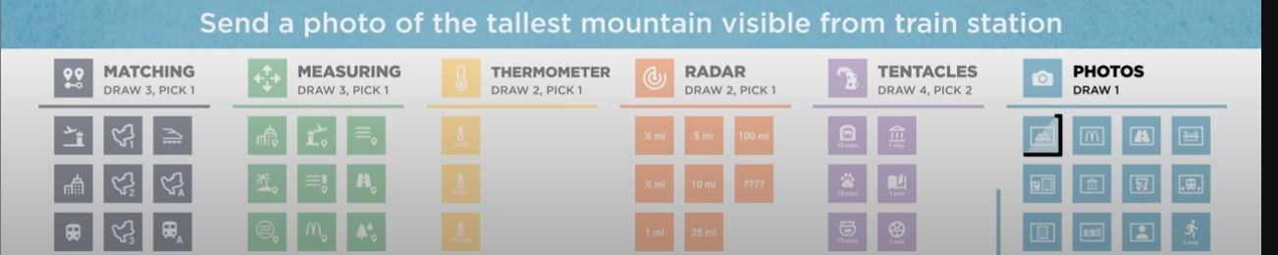












Slide 7
#F9402B
#F66B2B
#F99C35
#FFDE37
#C7DC51
#7CD046
#FD3769
#F04496
#8048A3
#4E60B4
#00C2FF
#009AD8

Slide 8
